Slide 1


Update on SACE’s Regional Work
July 1, 2026
Notes:
PLEASE MAKE COPY TO EDIT/USE

Slide 2
Unprecedented Political Times
Aggressive administrative hostility to climate and clean energy policy
MAGA ideological trifecta across the federal legislative and executive branches
1
4
Aggressive executive orders undermining decades of environmental, clean energy, and climate policy
Conservative majority on the Supreme Court
2
5
Fossil fuel industry takeover of key agency leadership positions
Expanding media-market consolidation amplifying hostile views on environmental and climate information
3
6
Notes:
USE THIS OR THE FIRST SLIDE AS TITLE SLIDE (THERE ARE 2 CHOICES)

Slide 3
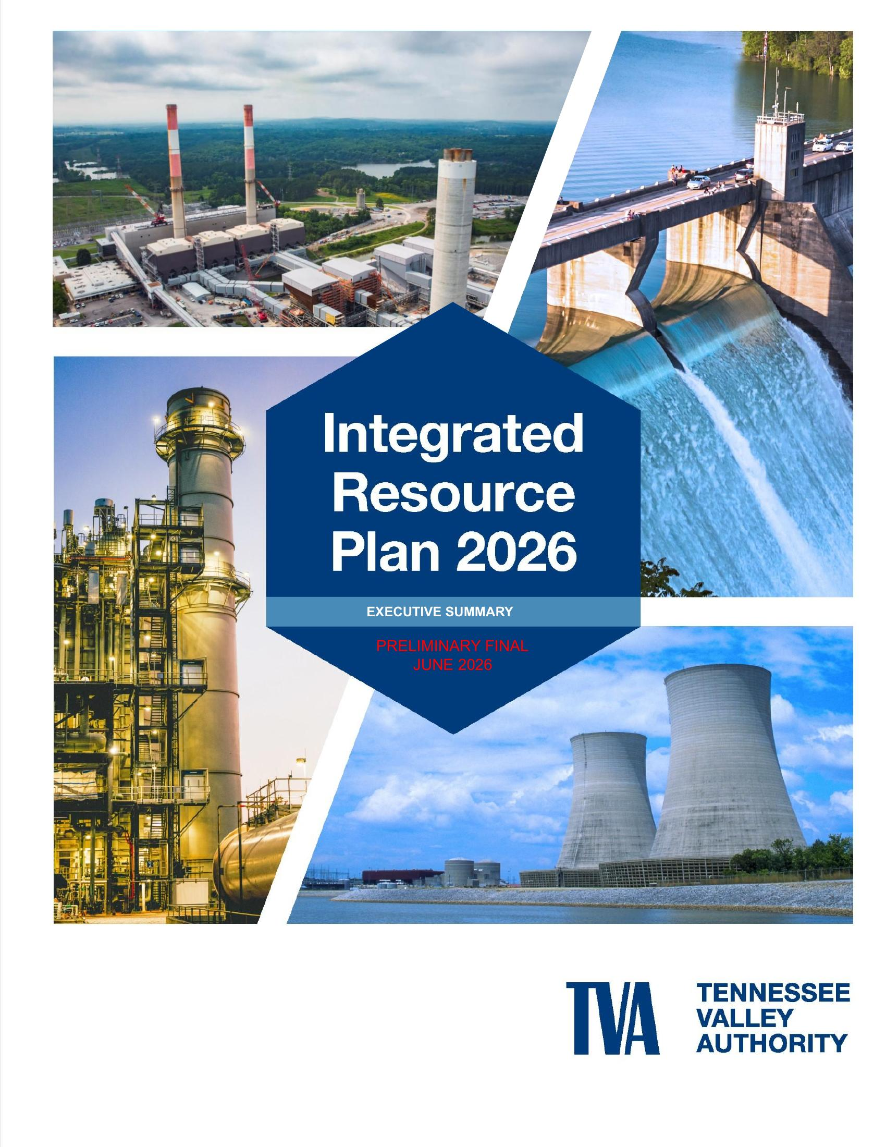
A CLOSER LOOK AT TVA’S PLAN
TVA’s New Draft Integrated Resource Plan
Preliminary Final 2026 IRP — published June 18, 2026

Slide 4
Evolving U.S. Energy Policy
National Energy Emergency Declared
Executive Order 14156 (January 20, 2025) formally declared a national energy emergency, reframing federal policy around expanded fossil fuel production.
1
EPA Regulatory Rollbacks
EPA moved to repeal all power-sector greenhouse gas standards under Clean Air Act Section 111 (the “2024 GHG Rule”) and let states extend coal wastewater (ELG) compliance deadlines.
2
One Big Beautiful Bill Act (July 4, 2025)
Rewrote investment tax credits for renewables, storage, and nuclear. Every IRP scenario now bakes in its higher clean-energy cost impacts.
3

Slide 5
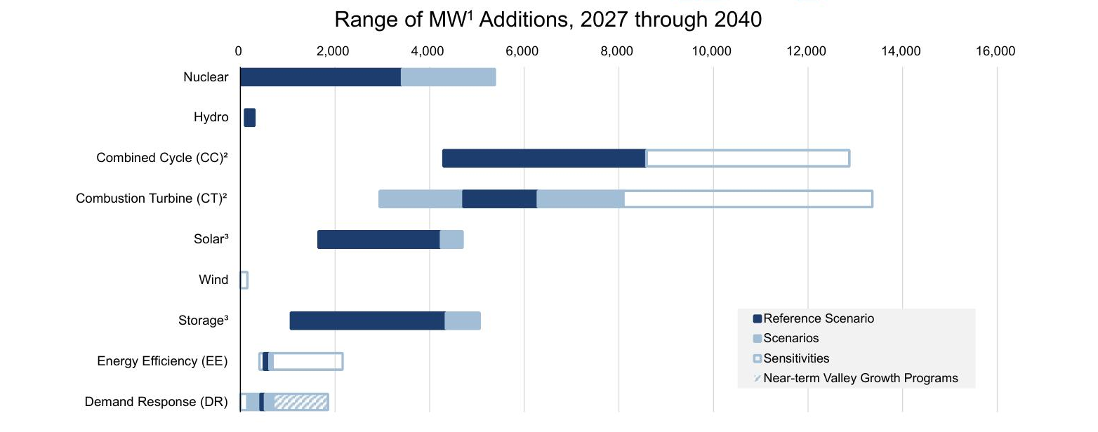
TVA’s Planned Resource Additions, 2027–2040
Gas (Combined Cycle + Combustion Turbine) dominates planned additions, while solar, wind, storage, and efficiency occupy far smaller ranges.
Source: TVA Preliminary Final 2026 IRP, Executive Summary, p. ES-11.

Slide 6
What Changed: 2024 Draft → 2026 IRP
Metric | 2024 Draft | 2026 Preliminary Final
Renewables added by 2040 | ~3.6–30 GW | ~1.7–4.7 GW (ceiling cut ~6×)
Efficiency + demand response | Broader range | Ceiling cut 60–70%
Gas added by 2040 | ~3.5–13.2 GW | ~7.2–16.7 GW (floor doubled)
Gas annual build limits | CC 2,860 / CT 1,768 MW/yr | Removed entirely
Coal trajectory | Ambiguous; EPA pressure | Operate through ~2040 (explicit)
Reference demand, 2035 | ~180 TWh | ~196 TWh (+9.2%)
CO₂ average (reference case) | ~34 Mt/yr | ~52 Mt/yr (+53%)

Slide 7
Gas Up, Coal Extended
GAS GENERATION
COAL
2×
~2040
Gas floor doubled by 2040 (~3.5 → ~7.2 GW)
Coal now runs through ~2040
2.15 GW gas CC + 1.87 GW gas CT hard-coded by 2030
Annual gas build limits removed entirely
Ceiling rises to ~16.7 GW of gas additions by 2040
Continued operation is an explicit IRP recommendation
Retirements hard-coded at ~2040 in the reference case
Justified to “reduce system cost and reliability risk”

Slide 8
Renewables & Efficiency Down
▼ 6×
▼ ~50%
▼ 60–70%
Renewables ceiling cut by 2040
Storage ceiling cut by 2040
Efficiency + demand response
(~30 → ~4.7 GW)
ceiling cut by 2040
Costs made it worse: 4-hour battery capital costs rose +88%, and post-ITC solar is ~2.5× more expensive than the 2024 Draft assumed.

Slide 9
The Bottom Line: Higher Costs & Higher Emissions
▲ +53%
▲ +23–35%
CO₂ emissions, reference-case average
Total revenue requirements (system cost)
vs. 2024 Draft (~34 → ~52 Mt/yr)
vs. 2024 Draft; +9–19% load-normalized
Capital costs rose across the board: batteries +88%, gas CC +49%, solar PPA +55%
Near-term additions (2027–2030) are hard-coded gas and solar
The model cannot select new resources until 2031 — just as load growth peaks

Slide 10
TVA is using its resource planning process to make political statements to the current administration, and it will result in higher electric bills across the Valley for decades to come.

Slide 11
Load Growth Across the Region: Georgia & North Carolina
Data centers are driving a historic demand surge — and a fossil-fuel buildout to match.
GEORGIA
NORTH CAROLINA
+50%
+2.7 GW
more power demand in just 6 years (Georgia Power)
jump in Duke’s Carolinas peak forecast in one cycle (+7.8%)
~8,500 MW of new load by 2030 — on a system of only ~14,000 MW today
~90% of it attributed to new data centers
GA PSC authorized ~9,900 MW of new capacity (Dec 2025), ~two-thirds gas
Hyperscale data centers moving fast through NC interconnection
Duke plans rising carbon emissions over the next decade
Trajectory puts NC’s 2050 carbon-neutrality goal out of reach
But is it real? Independent modeling finds AL/GA/NC/SC utilities are planning for data-center growth with only a ~0.2% chance of fully materializing — risking billions in stranded costs for ratepayers.
Sources: Georgia Power 2025 IRP & SACE; Georgia PSC (Dec. 2025); Duke Energy Carolinas load forecast; Greenlink Analytics / Science for Georgia (2025).

Slide 12
THANK YOU!
CONTACT INFORMATION
Stephen A. Smith, DVM
Executive Director
Southern Alliance for Clean Energy
sasmith@cleanenergy.org

